Slide 1
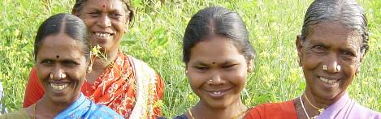
Experiences, challenges and opportunities in promoting neglected and underutilized species
Stefano Padulosi
Bioversity International
PSC and ETNA Summer School 2011, Klewenalp, 11 Sept 2011

Slide 2
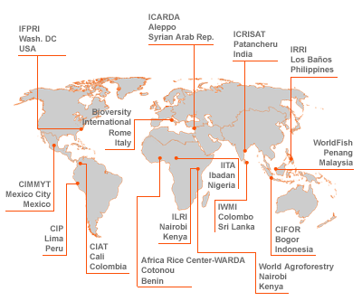

CGIAR: CONSULTATIVE GROUP ON INTERNATIONAL AGRICULTURAL RESEARCH
Notes:
CIAT - Centro Internacional de Agricultura Tropical
CIFOR - Center for International Forestry Research
CIMMYT - Centro Internacional de Mejoramiento de Maiz y Trigo
CIP - Centro Internacional de la Papa
ICARDA - International Center for Agricultural Research in the Dry Areas
ICLARM - International Center for Living Aquatic Resources Management
ICRAF - International Centre for Research in Agroforestry
ICRISAT - International Crops Research Institute for the Semi-Arid Tropics
IFPRI - International Food Policy Research Institute
IIMI - International Irrigation Management Institute
IITA - International Institute of Tropical Agriculture
ILRI - International Livestock Research Institute
IPGRI - International Plant Genetic Resources Institute
IRRI - International Rice Research Institute
ISNAR - International Service for National Agricultural Research
WARDA - West Africa Rice Development Association

Slide 3
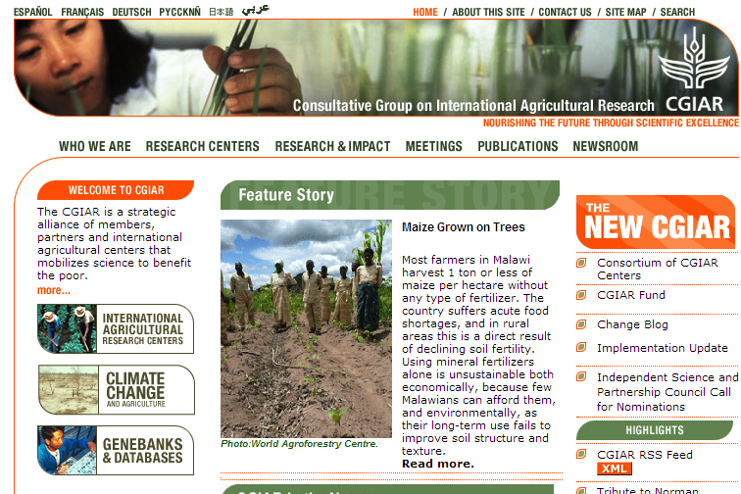
http://www.cgiar.org/

Slide 4
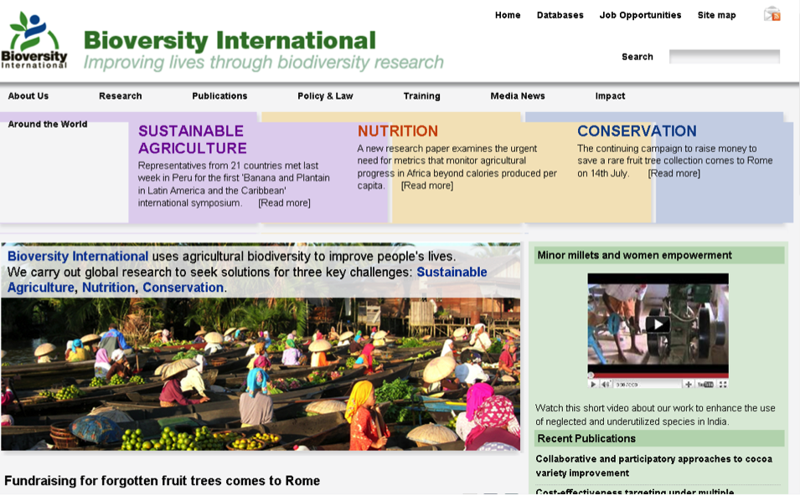
http://www.bioversityinternational.org/

Slide 5
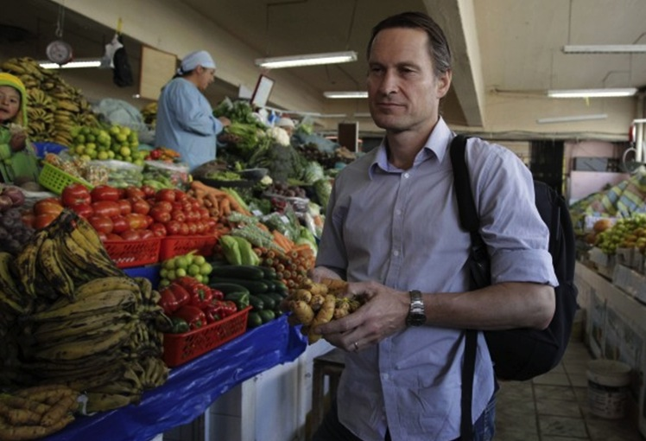
Claus Meyer, one of the best Chefs of the World, co-founder of Noma. Noma is a two Michelin star restaurant run by Meyer and René Redzepi in Copenhagen, Denmark. The name is an acronym of the two Danish words "nordisk" (Nordic) and "mad" (food), and the restaurant is known for its reinvention and interpretation of the Nordic Cuisine using local/traditional crops. In both 2010 and 2011, best Restaurant by Restaurant magazine.

Slide 6
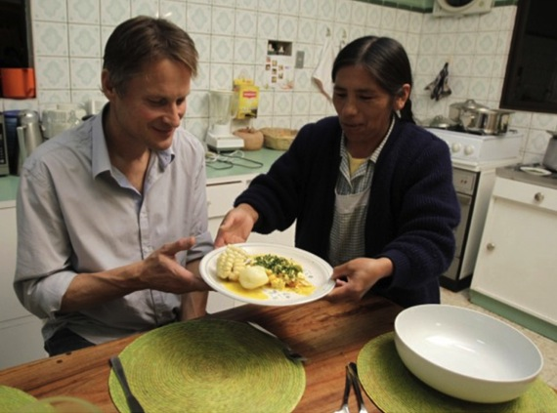
World Chef meets Bolivian household Chef

Slide 7

The Great Paradox of Todays’ Agriculture
300,000
100,000
30,000
7,000
120
30
3
Known plant species
Used by humankind
Edible
Used as food at local level
Important at national scale
Provide 90% of plant calories
Provide 60% (rice, wheat, maize)
Notes:
The narrowing down of the world’s food basket is limiting dramatically our ability to address malnutrition as well as retain many other well-being benefits originating from agricultural biodiversity. Recent food crises in 2008 has dramatically reminded us of that.

Slide 8
NUS

Slide 9
minor
Local
underutilized
underexploited
neglected
orphan
underdeveloped
NEW
niche
lost
promising
Traditional
ALTERNATIVE

Slide 10




  IFAD NUS Project
PHASE I (2001-2005) | PHASE II (2007-2010)
IMPLEMENTATION (3/7 cnts)
National Coordination India
National Coordination Bolivia
National Coordination Peru
Global Coordination

Slide 11
  IFAD NUS Project
OVERALL GOAL
Contribute to empowering the rural poor, raising incomes and strengthening the identity and food security of small farmers and rural communities worldwide by securing and exploiting the full potential of the genetic and cultural diversity contained in NUS.
OBJECTIVES
Enhance CAPACITIES of stakeholders on NUS
Strengthen CONSERVATION
Consolidate EVIDENCE on role of NUS
Testing novel approaches (ECOTOURISM)
Promoting enabling POLICY environment

Slide 12
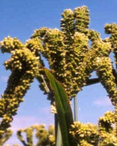
Our research scope
enhanced use, better nutrition, incomes and livelihood
Test the hypothesis that NUS can be instrument of development

Slide 13

How did we pursue this work?
Nutrition awareness Enabling Policies
Promotions
Education
Better varieties
Best practices
High Quality Seed
Novel food items
Recipes (old/new)
Quality standards
Genetic
diversity
Selection
cultivation
Harvest
Value addition
Marketing
Final
use
enhanced use, better nutrition, incomes and livelihood
Rescued diver.
Maps diversity
IK Document.
Conservation (ex situ/ in situ)
Improved technology
Eff. value chains
Commercialization Branding
Platforms of coop.

Slide 14
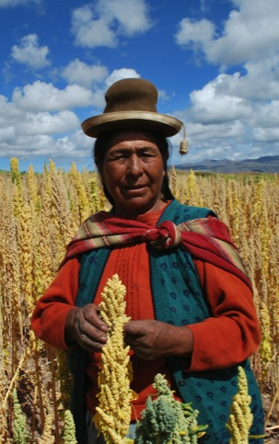
Approaches followed:
Highly Participatory
Community-based
Bottom up
Special attention to women
Holistic- ‘from farm to fork’
Trans-disciplinary
Inter-sectorial
Multi-stakeholders

Slide 15
Project Framework
Result of country-wide plus regional
stakeholders problem analysis/consultations
Same for all countries
Monitoring and impact assessment
Organized around 8 main activity areas:
Area 1: Assessment and enhancement of income generation based on NUS
Area 2: Assessment of nutritional values of NUS and development of strategies for their
enhanced use in nutrition programmes
Area 3: Enhancement of human and social capital of stakeholders to manage NUS and
derive benefits from their use, combined with strengthening of local identity
Area 4: Exploring the role of rural tourism in promoting NUS
Area 5: Improvement of availability, knowledge and maintenance of genetic resource
base.
Area 6: Promoting better policies and legal frameworks for the sustainable and equitable
use of NUS
Area 7: Promoting cooperation in NUS management and raising awareness of the
importance of NUS to livelihoods
Area 8: Mobilization of support and raising funds for NUS activities.

Slide 16
IFAD NUS Project Impact Pathway
mainstreaming
MAIN FOCUS
OUTPUTS
SPECIFIC
OBJECTIVES
OUTCOME
LEVEL1
OUTCOME
LEVEL 2
OUTCOME
LEVEL3
FINAL
IMPACT
To reinforce coping
strat. to tackle
climate change
using NUS
Better conserved,
characterized,
documented
PGR & IK
Better access
to basic needs
Reduced
neg. impact
of biotic
and abiotic
factors
Enhanced
production and
productivity in sites
Genetic, cultural
diversity & their
conservation
To rescue/restitute
PGR and IK
to users
diversity/IK
of NUS
safeguarded
Income gen.
opp. including
Agri-tourism
Assessed and
validated
To identify/
disseminate
adapted local/
improved vars
Enhanced
Diversity &
Practices
Novel/more attr.
alternatives
NUS income
gen. developed
Enhanced
Incomes
options
in target
Communities
Enhancement
living
conditions
of the poor in
target areas
through NUS
Income
Generation
Enhanced
human/social
capitals to
manage NUS
To enhance
NUS capacities/
entrepreneusp.
of stakeholders
Empowered
Women/
Target groups
Enhanced
linkages of
local produce
to markets
Enhanced
networking &
value chains in
sites/ region
Human/ social,
physical capacities
Enhanced vars.
and cultivation
practices
To enhance
self-esteem
of fragile groups
through NUS
Enhanced nutrit.
info of species
and products
Nutrit./ NUS
Policies
Implemented
by countries
Policies,
Public Awareness
Nutrition roles
of target spp
Assessd/enhanced
To enhance
offer / demand
of raw and
Processed NUS
products
Recomds. on
policies to fight
malnutrition
through NUS
developed
Better
nutrition
of fragile
Groups at
Regional/
ctry level
Better
knowledge
on Nutritional/
Proc. practices
gathered
Strategies
& prom. enabling
policy environ.
at national/ int.
level developed

Slide 17
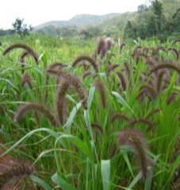
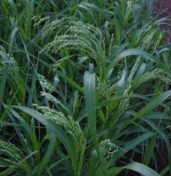
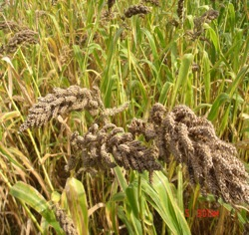
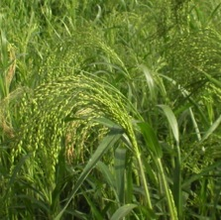
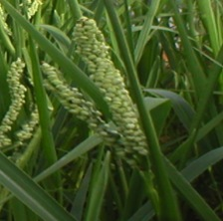
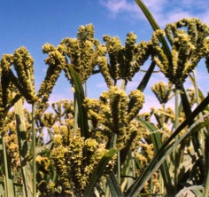
Target crops: minor millets
Foxtail millet
Little millet
Barnyard millet
More Advanced
Proso millet
Kodo millet
Finger millet

Slide 18
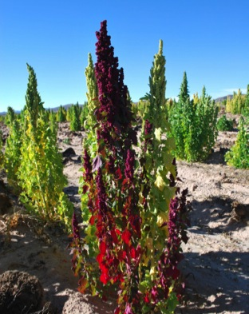
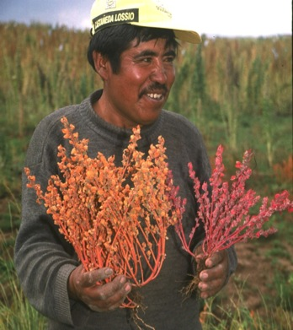
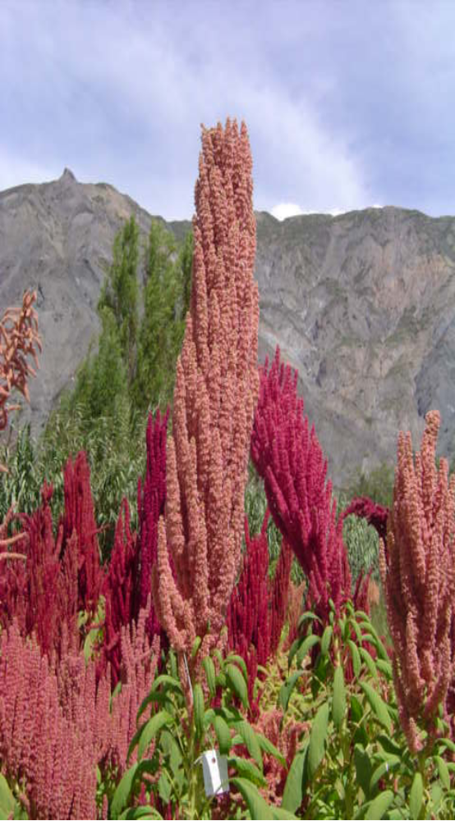
Target crops: Andean Grains
Quinoa
Cañihua
Amaranth
Chenopodium quinoa
Chenopodium pallidicaule
Amaranthus caudatus
More Advanced
Notes:
18

Slide 19
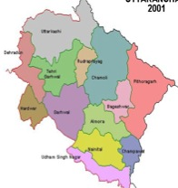
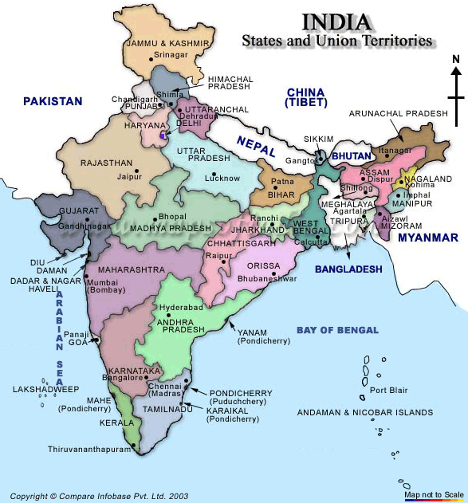
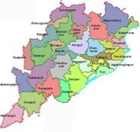
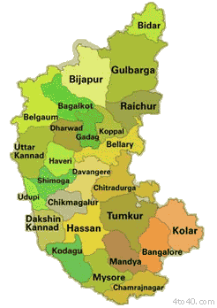
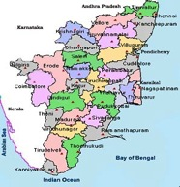
Project Sites: India (4 States)
1
7
3
2
6
4
5

Slide 20
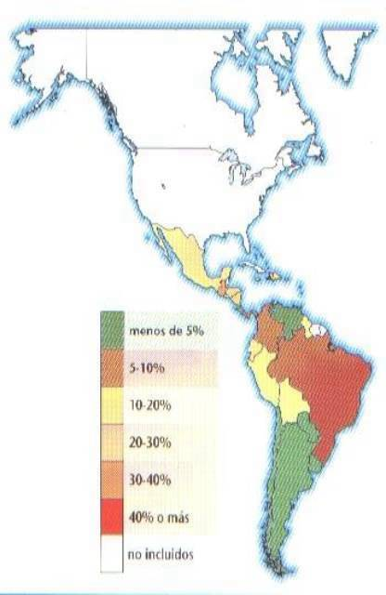

Project Sites: Bolivia (5 Departments)
La Paz
Cochabamba
Oruro
Potosí
Chuquisaca

Slide 21
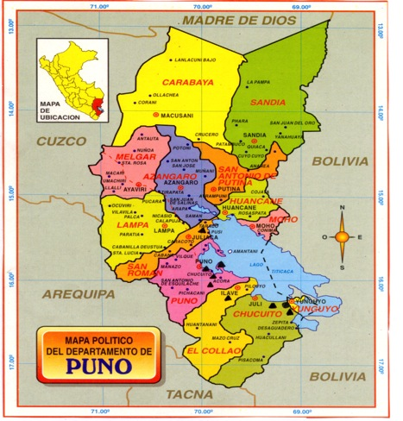
Project Sites: Peru (2 Regions)
Chilcapata, Occoruro
Anccaca, Huancarani, Laconi, Huarijuyo, Laraqueri
Corisuyo, Quinsachata , Cabanilla
Cieneguillas, Tiracoma, Vizallani, Cabana
Juli

Slide 22
People’s Participation
India:
31 Villages, >2,000 families
Bolivia and Peru: 34 villages, >1,170 families

Slide 23
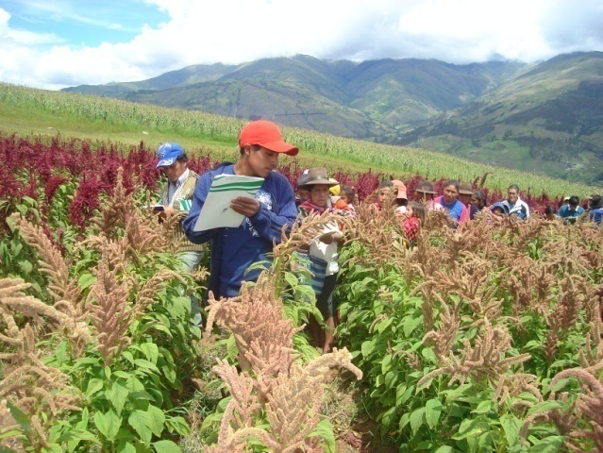
Highlights from the Project implementation

Slide 24
How did we pursue this work?
Genetic
diversity
Selection
cultivation
Harvest
Value addition
Marketing
Final
use
Collection / acquisition of germplasm
Maps of diversity
IK Documentation
Conservation (ex situ/ in situ methods)

Slide 25
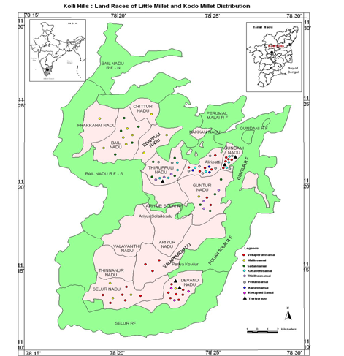
Mapping out distribution of target crops
(little millet, Kolli Hills) and assessing genetic erosion threats
Lesson: severe genetic erosion taking place in spite of appreciation by people of nutritional and cultural values

Slide 26
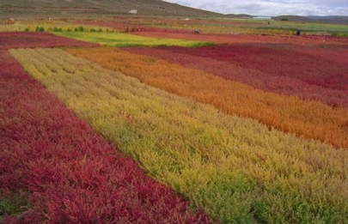
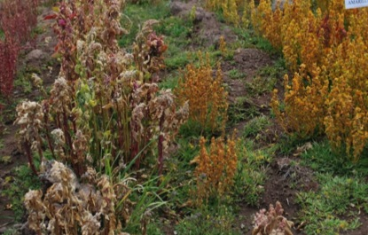
  Bolivia: re-introduction of lost diversity to farmers
Surveys involving 467 families across 5 provinces in the department of La Paz in Bolivia showed that only 40 varieties of quinoa and 20 of cañihua were being cultivated out of at least 200 varieties cultivated in the past. 85 % growers plant 1 landrace only
Between 2001 and 2008, 40 additional varieties (quinoa and cañihua) obtained from ex situ collections were successfully reintroduced to farmers’ fields.

Slide 27
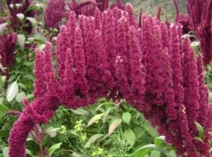
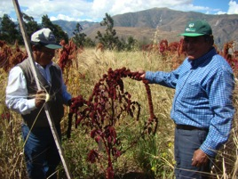
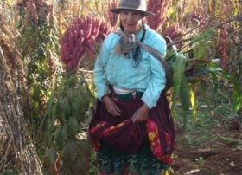
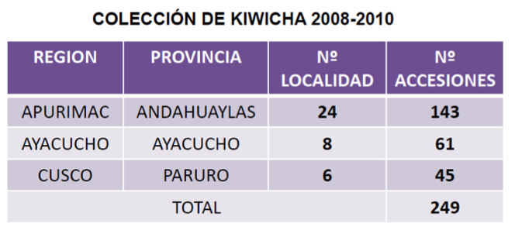
  Peru: rescuing and characterizing amaranth diversity

Slide 28
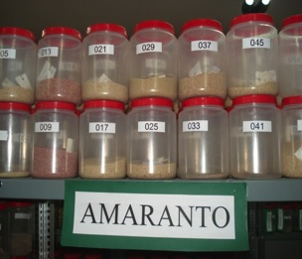
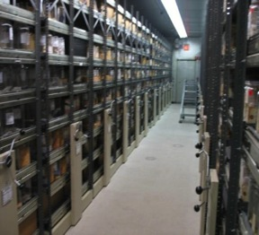
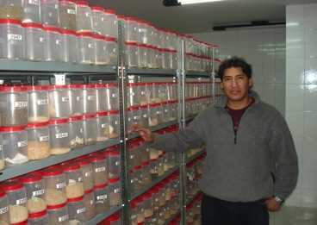
Bolivia: strengthening ex situ collections
Upgrading existing national seed collections of Andean grains in Peru and Bolivia through the improvement of their conservation capacities and the broadening of their genetic diversity coverage.
These measures have benefitted more than 7,000 accessions.
Notes:
28

Slide 29
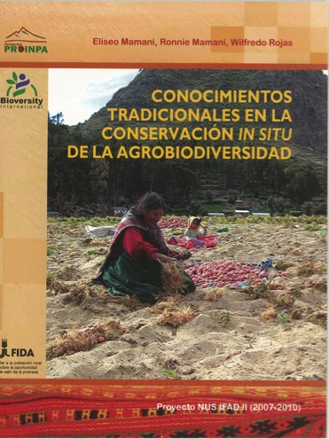
Safeguarding the Indigenous Knowledge associated to target crops
Lesson:
Activity particularly strategic for:
Valorization /use enhancement
Reintroduction of lost diversity
Self esteem/ identity

Slide 30

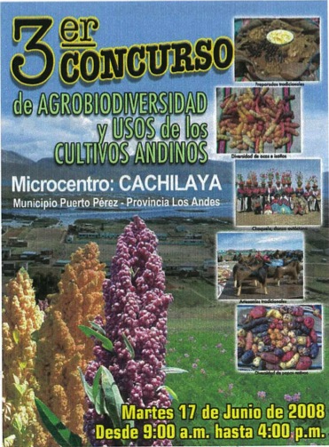
Biodiversity Fairs: celebrating and promoting crop diversity & knowledge

Slide 31
How did we pursue this work?
Improved varieties
Better cultivation practices
High Quality Seed
Genetic
diversity
Selection
cultivation
Harvest
Value addition
Marketing
Final
use

Slide 32
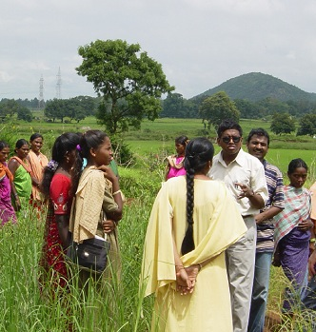
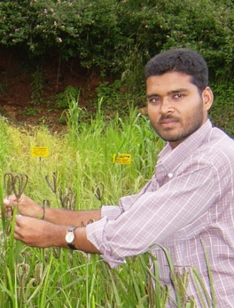
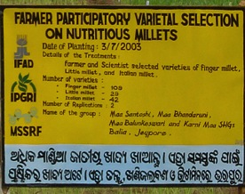
Participatory variety selection
India: from 2001 to 2008 more than 6000 acc. evaluated, focusing on peculiar traits (household, market and agronomic) and local conditions (e.g. rainfall patterns). Lesson: some local varieties preferred over improved types. The yield is not the only criteria followed by farmers in their selection.

Slide 33
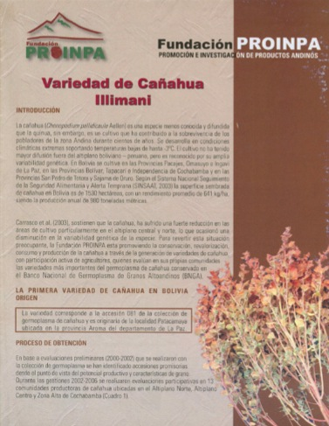
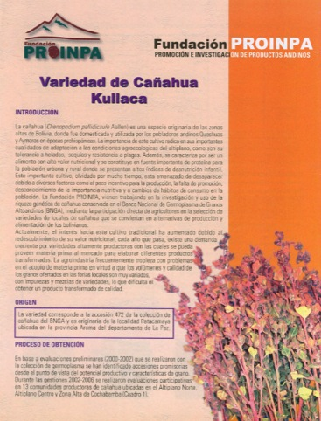
Bolivia: first ever cañihua vars. released!
As a whole several tons of high quality seeds produced by farmers trained by the project and distributed to communities..

Slide 34
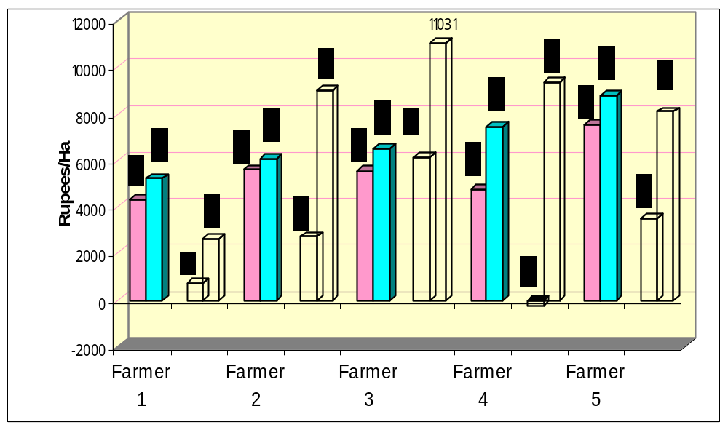
Improved cultivation practices
NET PROFIT- FARMER METHOD
NET PROFIT- IMPROVED METHOD
CoC = Cost of Cultivation
Net P = Net Profit
CoC
Net P
CoC
Net P
CoC
Net P
CoC
Net P
CoC
Net P

Slide 35
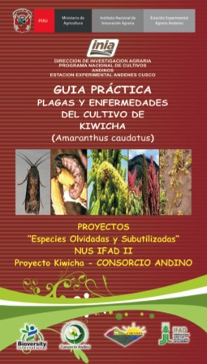
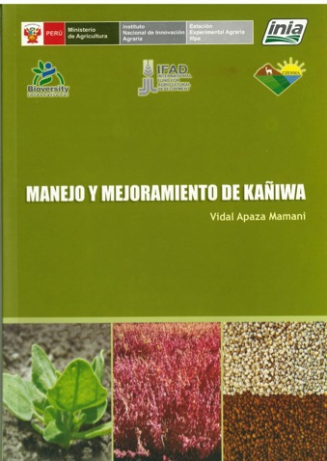
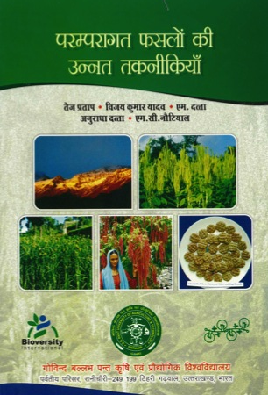

Manuals and cultivation guides

Slide 36
How did we pursue this work?
Improved harvest technology
Genetic
diversity
Selection
cultivation
Harvest
Value addition
Marketing
Final
use

Slide 37
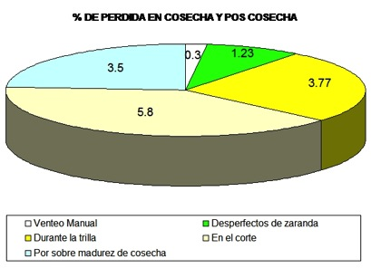
  Peru: reduction of grain losses during harvest and post harvest of amaranth
Etapas de evaluación | I | II | III | Media | DS | CV | % Pérdida total
A la sobre madurez de cosecha | 3.50 | 3.80 | 3.20 | 3.5 | 0.3 | 8.57 | 14.6
En el corte | 6.90 | 4.80 | 5.70 | 5.8 | 1.1 | 18.2
Durante la trilla | 3.40 | 3.60 | 4.30 | 3.77 | 0.5 | 12.6
Por despefectos de zarandas | 1.40 | 1.50 | 0.80 | 1.23 | 0.4 | 30.7
Por venteo manual | 0.30 | 0.40 | 0.20 | 0.3 | 0.1 | 33.3
Las evaluaciones de pérdidas de grano registrado en las diferentes fases de la cosecha y pos cosecha, nos demuestran que durante el corte en campo y la labor de trilla se registran mayores pérdidas en la producción de este cultivo, llegando a un total de 14.60% de pérdidas en las labores de cosecha y pos cosecha.

Slide 38
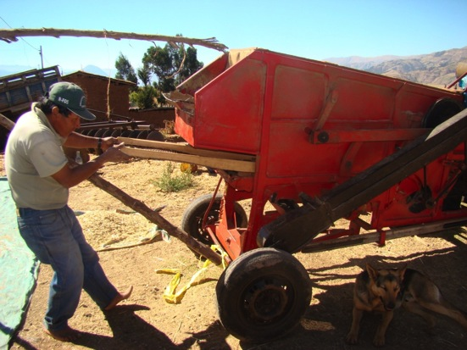
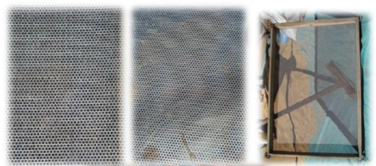
  A small innovation but important benefits..

Slide 39
How did we pursue this work?
Improved value addition
technology
Genetic
diversity
Selection
cultivation
Harvest
Value addition
Marketing
Final
use

Slide 40
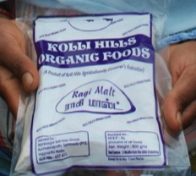





Elimination of drudgery in processing

Slide 41






Lesson: community-based value addition processing centers represent strategic opportunities for community development..
Mini mill
Grain de-stoner
FM flour mill
FM malt mill
FM thresher
Millet de-huller

Slide 42





Greater efficiency in de-saponification (from 1-4 hrs to just 7 minutes!)
Bolivia: drudgery in processing quinoa

Slide 43
More profitable food items from NUS! Lesson: ample scope for scaling up successful enterprises started in project sites
Name of the product | Quantity | Cost of prod. (Rs.) | Selling price (Rs.) | Total income Rs | Profit %
Polished foxtail millet | 1 Kg | 34 | 40/Kg | 40 | 17.64
Polished little millet | 1 Kg | 34 | 40/Kg | 40 | 17.64
Diabetic mix | 1 Kg | 80 | 100/Kg | 100 | 25.00
Bisibelebath mix | 1 Kg | 90 | 100/Kg | 100 | 11.11
Kusubi savi rice mix | 1 Kg | 60 | 100/Kg | 100 | 40.00
Ragi Malt | 1 Kg | 65 | 100/Kg | 100 | 54.00
Ragi Malt Drink | 500 ml | 106 | 3/100 ml | 150 | 68.00
Savi Paddu | 100 nos | 70 | 5/4 nos | 125 | 78.00
Biscuits/Muffins | 4 Kg | 200 | 80/Kg | 320 | 33.00
Savi Chakkali | 1.2kg | 85 | 100/Kg | 120 | 41.17
Savi Shevu | 1.2kg | 85 | 100/Kg | 120 | 41.17
Tengalu | 1.2kg | 85 | 100/Kg | 118 | 38.82
Little millet papad | 200 nos | 150 | 200 | 200 | 50%
Besan Laddu | 1.250 Kg | 80 | 160 | 200 | 150%

Slide 44

Lead contamination in popped grains
Re-designed technology

Slide 45





The solution developed by IFAD NUS
Method now used by all exporting firms in Bolivia – efforts now to promote change also among small producers – important policy implications..
Traditional “expansors”
type “batch”
Details of lid covered with lead
Modified machine
Lid made of teflon

Slide 46
How did we pursue this work?
Novel food items
Recipes (old/new)
Quality standards
Genetic
diversity
Selection
cultivation
Harvest
Value addition
Marketing
Final
use

Slide 47










































Blending tradition with modern food trends..
KOLLI HILLS TRADITIONAL RECIPES OF SAMAI (Little Millet) & THINAI (Italian Millet)
Samai Rice Thinai Rice Samai Uppuma Thinai Uppuma Samai Poorna Kozhukkatai Samai Kara Kozhukkatai Thinai Poorna Kozhukkatai Thinai Kara Kozhukkatai
Samai Sweet Puttu Thinai Sweet Puttu Samai Sweet Pongal Thinai Sweet Pongal Samai Sweet Idiappam Samai Thinai Kara Idiappam Thinai Sweet Idiappam Samai Thinai Sweet Paniyaram
Samai Kara Paniyaram Thinai Kara Paniyaram Samai Payasam Thinai Payasam Samai Idli Thinai Idli Samai Dosai Thinai Dosai
Samai Wheat Flour Dosai Thinai Wheat Flour Dosai Samai Kara Pongal Thinai Kara Pongal Samai Thinai Keera Roti Samai Bonda Samai Pakoda Thinai Bonda
Thinai Pakoda Samai Thinai Ribbon Pakoda Samai Thinai Omapodi Samai Thinai Adai Samai Thinai Vadai Samai Thinai Murukku Thinai Adhirasam Samai Thinai Kachayam
(Photograph: courtesy of Dr. E. D. Israel Oliver King)

Slide 48






  Develop better dishes using most suitable genetic diversity..
Panqueques
Preparados | Variedades y/o Accesiones
Tawas de quinua | Acc. 2511 - 2489
Panqueque de quinua | Acc. 2511 - 0027
Buñuelo de quinua | Acc. 2417
Jugo de quinua | Acc. 0027
Api de quinua | Acc. 1474
Pan de quinua | Variedad Local
Tawas
Buñuelos

Slide 49
Análisis Nutricional Productos Procesados
  Assessing nutritional values in grains and processed items..
Análisis Nutricional (productos procesados) | Cereal Amaranto con miel | Pop de amaranto | Kallpa energética amaranto maca | Galletas de amaranto | Barra energética maca amaranto | Barra energética quinua, maca, amaranto
Calorías Kcal./100 g | 430 | 422 | 393 | 468 | 414 | 378
Proteína % | 20.1 | 13.2 | 10.1 | 9.22 | 9.28 | 5.57
Grasa % | 13.8 | 10.4 | 5.47 | 17.9 | 8.18 | 1.95
Carbohidratos Totales % | 56.3 | 69.1 | 75.9 | 67.5 | 75.8 | 84.4
Fibra g/100 g | 3.05 | 6.15 | 4.20 | 2.98 | 4.39 | 1.17
Calcio mg-Ca/100 g | 68.3 | 99.7 | 107 | 36.3 | 89.4 | 21.9
Hierro mg-Fe/100 g | 4.29 | 5.23 | 7.38 | 1.39 | 2.95 | 3.31
Vitamina C mg/100 g | 7.14 | 3.42 | 9.10 | 6.50 | 10.1 | 4.42

Slide 50


Branding and trade mark established. Lesson: strategic tool for self esteem and empowerment of communities

Slide 51


Lesson: ample scope for contributing towards empowerment of women
Capacity Building Training on Value Addition at Home Sciences College, UAS- Banagalore facilitated by
Prof. Vijalakshmi & Dr. Geetha
Notes:
51

Slide 52


Changing the food-of-the-poor stigma through strategic partnership with private sector-Bolivia (Alexander Coffee)

Slide 53


Better policies: Bolivia
Output: Technical norms for definition, classification and requirements regarding the commercialization of AG (together with Governments Agency IBNORCA-Bolivia and INCODEPI-Peru and value chain actors)

Slide 54
How did we pursue this work?
Nutrition awareness Enabling Policies
Promotion
Education
Genetic
diversity
Selection
cultivation
Harvest
Value addition
Marketing
Final
use

Slide 55

Mainstreaming nutritious millets into school meals
Project with the Univ. Bangalore and the Dept. of Women & Child Welfare, Govt. of India.
Working to introduce millet-based recipes in school meals with better overall nutritional profile and competitive costs.
Also lobbying for introducing nutritious millets into the India’s PDS
Lesson: role of policy makers (we need more champions like Prof. Swaminathan!) is highly strategic to achieve larger impact through mainstreaming..
The Hindu: May 6, 2009.

Slide 56








Slide 57

Many articles in newspapers in national and local languages; radio and TV programs, videos,etc..

Slide 58

BBC Video
http://news.bbc.co.uk/2/hi/science/nature/7247218.stm

Slide 59

Educating the younger ones

Slide 60





SCHOOL COMPETITIONS
MSSRF

Slide 61
Impact on livelihood?
Genetic
diversity
Selection
cultivation
Harvest
Value addition
Marketing
Final
use
enhanced use, better nutrition, incomes and livelihood

Slide 62


Lesson: acquisition of entrepreneurial skills very powerful for raising women self-esteem.
56 SHGs established in 27 villages 386 (214 women involved)
Additional income for improved finger millet flour, semolina and malt generated by SHG have been USD 25, 100 and 430 per ton of product respectively.
‘exit strategy’ and
sustainability
Ms Jaya
Appusamy (Kolli Hills, Tamil Nadu)
Members of a Self-Help Group in Kolli Hill (Tamil Nadu) proudly presenting their products sold in local markets
enhanced skills, recognition, self esteem, confidence..

Slide 63



Enhancing income generation
Case of Bolivia: technology introduced by the Project has contributed to additional income from Andean grains among processors in the tune of:
Cañahua: 8,700 Bs/ton (1,255 USD/ton)
Amaranth: 4,500 Bs/ton (649 USD/ton)

Slide 64



Empowerment of rural communities
Case of Bolivia: Producers of cañahua in Coromata Media thanks to the AINCOCA Association established through the Project are now able to effectively commercialize cañahua and gain greater economic benefits...

Slide 65





Strengthening nutrition in children
Bolivia: Project succedeed in including food items containing amaranth in school meal programmes of the cities of Sucre and Serrano: an estimated income of at least 3 mil Bs (400K $)/ year for the amaranth value chain sector as a result of this policy in the Chuquisaca Department.

Slide 66
Conservation impact
Outcome: (2008-2009)
Coromata: 102 to 161 vars.
S. Okola: 89 to 131 vars.

Slide 67

Agritourism: a successful story

Slide 68

Community Museum

Slide 69
The many challenges..
Bridging agendas of different players
Working with limited resources / staff
Working with limited data and capacities
Investing on exit strategy- policy issues
Realizing both Res. and Dev. objectives

Slide 70
Take home messages
Yes! NUS can be instruments of development and bring about sustainable benefits! But holistic approach is essential!
Involvement with private sector, associations (SHG) Platforms (Bol/Peru) strategic in exit strategies;
Need to create synergies beyond the traditional ‘PGR’ world and link-up with other research groups;
Approaches, methods, tools can be exported to other crops and countries but capacities to tackle such a holistic approach is needed (see other presentation);
Sustainable conservation resulting out of effective use enhancement strategies!
Ex situ and in situ/on farm to complement each other!
Essential role of policy makers in mainstreaming.

Slide 71
The newly approved
IFAD-Project
Title: “Reinforcing the resilience of poor rural communities in the face of food insecurity, poverty and climate change through on-farm conservation of local agrobiodiversity.” (Grant 1241)
Countries and coordination:
Global: Bioversity International (Italy)
National: M.S. Swaminathan Research Foundation – MSSRF (India); Local Initiative for Biodiversity, Research and Development -LIBIRD (Nepal); Fundación Promoción e Investigación de Productos Andinos -PROINPA (Bolivia) and Oxfam-Novib (1 yr).
Budget: 1.5 M USD (IFAD, EU-CGIAR and CCAFS)
India: 260K USD
Duration: 3 years (2011-2014)

Slide 72
Issues of Concerns
Loss of diversity/IK: While scaling up of approaches, methods and tools developed insofar are being advocated in other countries and species, more work is needed to address issue of dwindling NUS diversity/IK in production systems in the face of climate change;
Adaptation/on farm work and research on their distribution and use, trends affecting their use, custodian farmers and where-when–how ABD-rich practices facilitate adaptation to climate change.

Slide 73

How to support Custodians of Biodiversity?
Ageing farmers: we need to keep their legacy alive in young generations along with a wealth of traditional knowledge now being FAST ERODED.
Gone with these are also culture, traditions and self-esteem of local communities whose identity is closely associated to local crops/ uses..

Slide 74

Loss of Indigenous Knowledge
2003 Ethnobotanic study on wild species in Lebanon covering 12 villages, 60 plant Families, 260 vernacular names with 1,400 use citations recorded.
USES
Fresh 494
Cooked 478
Pickled 76
Spice 36

Slide 75

Mapping out NUS diversity: fundamental for their promotion
Extremely limited is our understanding of the distribution of NUS, their uses and threats. This is fundamental in order to guide interventions aimed at strengthening both their conservation and use.
Map of distribution of little millet in Kolli Hills (source MSSRF)

Slide 76



What mechanisms to promote access, exchange and use?

Slide 77

Can participatory documentation and monitoring be a viable approach?
Community Biodiversity Registers

Slide 78
Project’ s OBJECTIVES
Develop and test new methods and tools in close partnership with farmers and value chain actors aimed at enhancing their capacities to sustainably conserve traditional crops and associated knowledge at the farm level;
Explore ways of integrating the monitoring of diversity on-farm, along with use-enhancement goals, through inter-disciplinary and multi-sector approaches (note RED LIST for cultivated species);
Promote a more balanced complementary conservation agenda in national programmes, based on the need to combat genetic erosion and to meet the needs of agrobiodiversity users; and
Provide useful findings to guide further research related to climate change and its impact on species and varieties deployed in local production systems.

Slide 79

Thank you!

